Slide 1
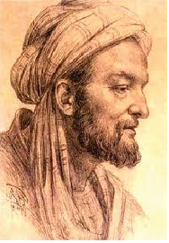
“JABIR BIN HAYAN”
Done by :-
Fatima Salah
Reem Nassir
Hattan
Ahood

Slide 2
Jabir bin Abdullah al-Azdi
Jabir Ibn Hayan was one of the best Arab Muslims scientist he was a chemist and alchemist, also engineer, philosopher, pharmacist and physician. Jabir is held to have been the first practical alchemist.

Slide 3
His life
he was born in 721 in Tus, Persia, and he died in 815 in Kufa in Al Iraq.
He began his career practicing medicine in Kufa, under the support of a Vizir of Caliph Harun al-Rashid. Also he was a student of the sixth Imam Ja'far al-Sadiq and Harbi al-Himyari.

Slide 4
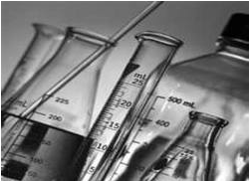
The Jabirian corpus
In entire, nearly 3,000 treatises and articles are credited to Jabir ibn Hayyan.
Although the scope of the corpus is vast : cosmology, music, medicine, magic, biology, logic, artificial generation of living beings, along with astrological predictions, and symbolic Imâmî myths.

Slide 5
Jabir’s Books
Geber many branches of science is chemistry, wrote in philosophy, astronomy, medicine, nature, and trusted his writings :-
1- book stones which is four parts. 2- authors for a chemistry book. 3- authors Silver Moon any book. 4- authors of the sun means gold. 5- Book of Secrets.

Slide 6
Jabir Ibn hayan’s invention
He invented and explored many things about chemistry, and he was inspired from his teacher Ja'far as-Sadiq. One of the most important scientific contributions to Jaber in chemistry was introduction of the experimental method to chemistry, an inventor known alkali in terms of modern chemistry Arab name (Alkali). The nature and properties of elements was defined through numeric values assigned the Arabic consonants present in their name.

Slide 7
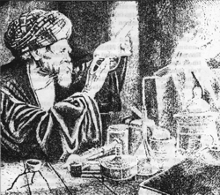
Jabir Ibn Hayan’s achievements
First discovered sulfuric acid.
Enter improvements to roads evaporation and liquidation of fusion and crystallization, distillation.
He succeeded in the development of the first distillation method in the world, Has invented distillation apparatus.
First of conjuring water gold.

Slide 8
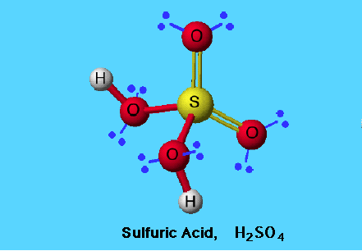
Sulfuric acid
Jabir Ibn Hayyan was the first science who discovered sulfuric acid. He mixed sulfur trioxide with water to create sulfuric acid in the 8th century. A century later, Ibn Zakariya al-Razi, a Persian physician and alchemist, continued studying the acid and discovered it had the ability to destroy iron and copper oxide.

Slide 9
Sulfuric acid is an oily, colorless liquid with no odor. It is a key component in batteries, wastewater treatment, ore production, and fertilizer creation. Sixty-five percent of all fertilizers available on the market today are created from a combination of this acid and other chemicals. It is created from inorganic materials through a process that utilizes a special type of chemical reaction.

Slide 10
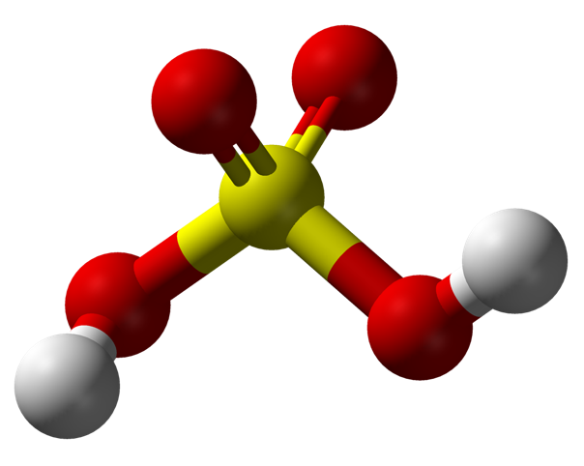
Benefits of Sulfuric acid
A variety of substances can be mixed with sulfuric acid in order to create new products. Sulfur can be mixed with forms of aluminum to create aluminum sulfates. When aluminum sulfates are mixed with wood pulp, the fibers bond together and create paper. Aluminum sulfates mixed with dioxides create a mixture that takes impurities out of water. These aluminum dioxides are commonly used at water treatment plants.

Slide 11
Due to the acid's unstable properties, it is essential for those combining it with water to add it to the water and not the other way around. If water is poured into sulfuric acid, a volatile explosion of boiling water can be created. Though the acid is non-flammable, it can create hydrogen gas, which is highly volatile.

Slide 12
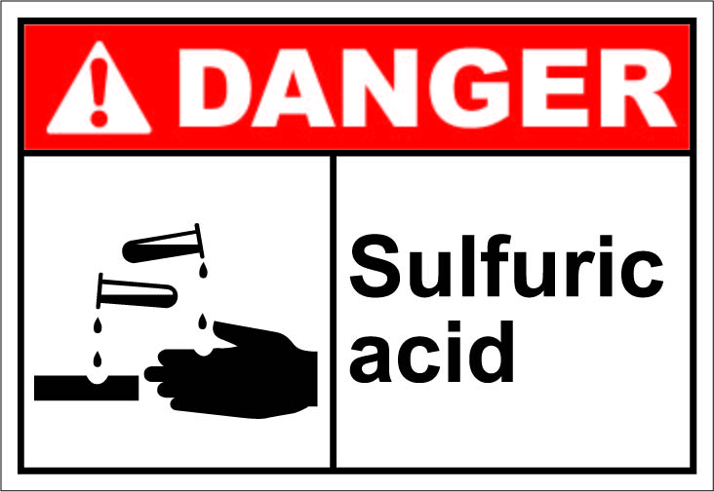
You can know more about Jaber Ibn Hayyan by watching this movei about hem in youtube:
http://www.youtube.com/playlist?list=PLFE681A5F186F1D6C

